Slide 1
Dispatcher view
Gabriel Nagy

Slide 2
Description
The Dispatcher design pattern separates view responsibilities from business and system logic, and separates Web production and software development teams. The Dispatcher pattern can meet the following needs
Dynamic content generation
Business logic encapsulation in a camp other than the view:

Slide 3
The Dispatcher pattern therefore becomes responsible for view management and navigation.
It is best employed when outside resources choose the view.
For example, the Service-to-Worker pattern collects data before the dispatcher comes into use so that the dispatcher can choose the view based on the data collected. That scenario contrasts with the typical dispatcher, which chooses the view based on state information; in such a case, the view decides what data to pull.

Slide 4
Solutions
Developers most commonly employ the Dispatcher pattern with a request-handling controller.
A controller can be implemented with a servlet, a JavaServer Page (JSP), or a component that delegates dispatch responsibilities to the Dispatcher object.
The following image’s sequence diagram demonstrates the process.

Slide 5
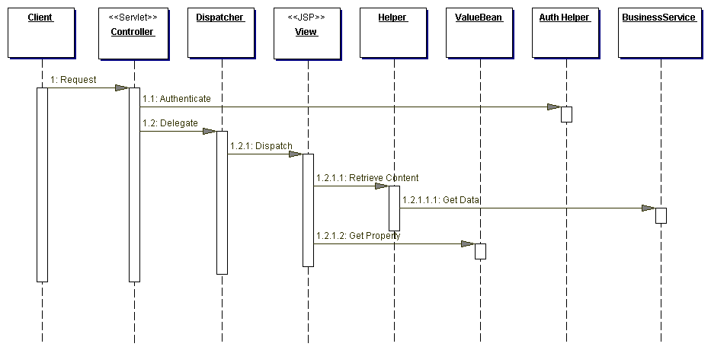

Slide 6
Structure of a Dispatch View
The structure of the dispatch view pattern is such that it has several components. Each plays a certain role and caters to specific responsibilities. There is a controller, dispatcher, view, helper, value bean and business service.
The controller is generally, the contact point for handling a certain request. It is responsible for managing, authenticating and authorizing and delegating to do view management to the dispatcher.
A dispatcher manages view and navigates. It is also responsible for managing the choice for the next view to the present.
A view is responsible for representing and displaying information to the client.
A helper helps the view or controller to complete its processing. The client is looking forward to accessing a particular service, which fulfills the business service role.

Slide 7
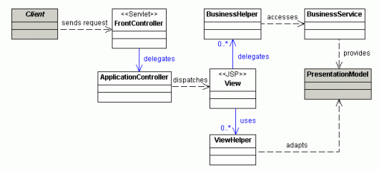
The following Class diagram illustrates the Dispatch View design pattern:

Slide 8
Strategies
Many strategies can be found for implementing a dispatcher. Sun's “J2EE Patterns Catalog” proposes several:
Servlet Front Strategy: A servlet determines workflow using the request, which the servlet then forwards to the appropriate view.
JSP Front Strategy: A JSP determines workflow, then forwards the request to the view.
JSP View Strategy: A combination of the JSP Front and the presentation logic. The JSP determines which view to use based on the request; this can be achieved with something as simple as an if statement.
Servlet View Strategy: Similar to the JSP View Strategy, except it employs servlets.
JavaBean Helper Strategy: A JavaBean dispatches to the view based on the request.
Custom Tag Helper Strategy: A tag library dispatches from a JSP.
Dispatcher in Controller Strategy: The Controller performs the dispatching.

Slide 9
The XSL Dispatcher solution
The solution applies XSL to an XML representation of the current session information, along with additional state information such as the current view, the user's security role, and whatever other information might be handy.
The consequences of using an XSL Dispatcher include:
An increased level of modifiability
The ability to reuse views with different workflows
Reusable workflow API

Slide 10
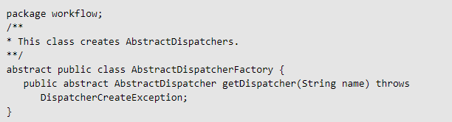
Important classes and their responsibilities
AbstractDispatcherFactory
The abstract AbstractDispatcherFactory class employs the Builder pattern to create dispatchers:

Slide 11
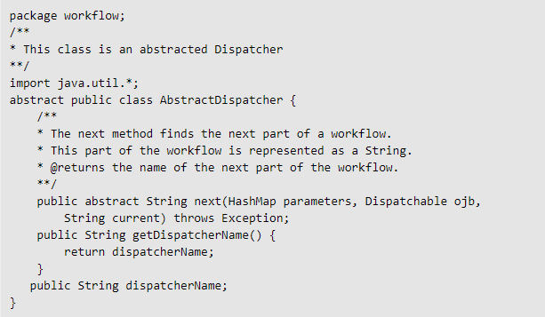
AbstractDispatcher
The abstract AbstractDispatcher class dispatches an object. Its next() method determines the next screen in a workflow:

Slide 12
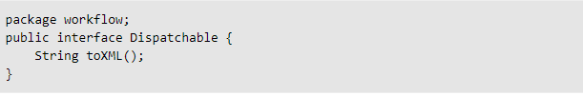
Dispatchable
The Dispatchable interface represents a dispatchable object. Because it is an interface, you must implement Dispatchable in order for the API to use it:

Slide 13

DispatcherCreateException
The DispatcherCreateException exception throws if the AbstractDispatcherFactory cannot create a dispatcher:

Slide 14
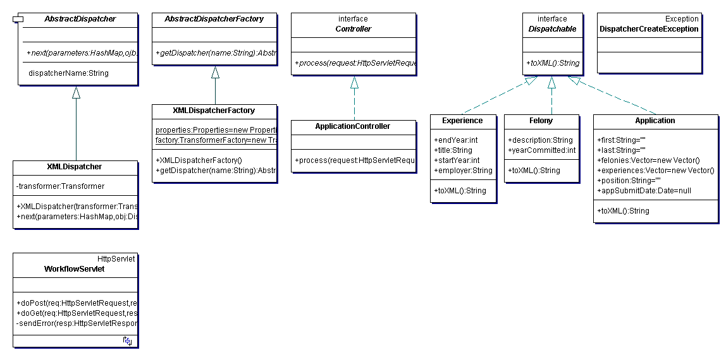
This figure illustrates the relationship between the classes:

